Slide 1
Discrete Mathmatics
CSE 1107
Module
Number Theory
Rosen, Sections 3-4 to 3-7.

Slide 2
The Integers and Division
Of course, you already know what the integers are, and what division is…
However: There are some specific notations, terminology, and theorems associated with these concepts which you may not know.
These form the basics of number theory.
  Vital in many important algorithms today (hash functions, cryptography, digital signatures; in general, on-line security).

Slide 3
The divides operator
New notation: 3 | 12
  To specify when an integer evenly divides another integer
  Read as “3 divides 12”
The not-divides operator: 5 | 12
  To specify when an integer does not evenly divide another integer
  Read as “5 does not divide 12”

Slide 4
Divides, Factor, Multiple
Let a,b∈Z with a≠0.
Defn.: a|b ≡ “a divides b” :≡ (∃ c∈Z: b=ac)
“There is an integer c such that c times a equals b.”
  Example: 3|−12 ⇔ True, but 3|7 ⇔ False.
Iff a divides b, then we say a is a factor or a divisor of b, and b is a multiple of a.
Ex.: “b is even” :≡ 2|b. Is 0 even? Is −4?

Slide 5
Results on the divides operator
If a | b and a | c, then a | (b+c)
  Example: if 5 | 25 and 5 | 30, then 5 | (25+30)
If a | b, then a | bc for all integers c
  Example: if 5 | 25, then 5 | 25*c for all ints c
If a | b and b | c, then a | c
  Example: if 5 | 25 and 25 | 100, then 5 | 100
(“common facts” but good to repeat for background)

Slide 6
Divides Relation
Theorem: ∀a,b,c ∈ Z:
  1. a|0
  2. (a|b ∧ a|c) → a | (b + c)
  3. a|b → a|bc
  4. (a|b ∧ b|c) → a|c
Corollary: If a, b, c are integers, such that a | b and a | c, then
a | mb + nc whenever m and n are integers.

Slide 7
Proof of (2)
Show ∀a,b,c ∈ Z: (a|b ∧ a|c) → a | (b + c).
Let a, b, c be any integers such that a|b and a|c, and show that a | (b + c).
By defn. of | , we know ∃s: b=as, and ∃t: c=at.
Let s, t, be such integers.
Then b+c = as + at = a(s+t).
So, ∃u: b+c=au, namely u=s+t. Thus a|(b+c). QED

Slide 8

Divides Relation
Corollary: If a, b, c are integers, such that a | b and a | c, then a | mb + nc whenever m and n are integers.
Proof:
From previous theorem part 3 (i.e., a|b → a|be) it follows that a | mb and a | nc ; again, from previous theorem part 2 (i.e., (a|b ∧ a|c) → a | (b + c)) it follows that a | mb + nc

Slide 9
The Division “Algorithm”
Theorem:
Division Algorithm --- Let a be an integer and d a positive
integer. Then there are unique integers q and r, with 0 ≤r < d,
such that a = dq+r.
It’s really a theorem, not an algorithm…
  Only called an “algorithm” for historical reasons.
q is called the quotient
r is called the remainder
d is called the divisor
a is called the dividend

Slide 10
q is called the quotient
r is called the remainder
d is called the divisor
a is called the dividend
What are the quotient and remainder when 101 is divided by 11?
a d q r
101 = 11 × 9 + 2
We write:
q = 9 = 101 div 11
r = 2 = 101 mod 11

Slide 11
If a = 7 and d = 3, then q = 2 and r = 1, since 7 = (2)(3) + 1.
If a = −7 and d = 3, then q = −3 and r = 2, since −7 = (−3)(3) + 2.
So: given positive a and (positive) d, in order to get r we repeatedly subtract d from a, as many times as needed so that what remains, r, is less than d.
Given negative a and (positive) d, in order to get r we repeatedly add d to a, as many times as needed so that what remains, r, is positive (or zero) and less than d.

Slide 12
Theorem:
Division “Algorithm” --- Let a be an integer and d a positive integer. Then there are unique integers q and r, with 0 ≤r<d, such that a=dq+r.
Proof:
We’ll use the well-ordering property directly that states that every set of nonnegative integers has a least element.
Existence
We want to show the existence of q and r, with the property that
a = dq+r, 0 ≤r <d
Consider the set of non-negative numbers of the form a - dq, where q is an integer.
Hmm. Can this set be empty?
Note: this set is non empty since q can be a negative integer with large absolute value.
By the well-ordering property, S has a least element, r = a - d q₀.

Slide 13
q is called the quotient
r is called the remainder
d is called the divisor
a is called the dividend
(Existence, cont.)
r is non-negative; also, r < d.
otherwise if r≥ d, there would be a smaller nonnegative element in S, namely
a - d(q₀+1) ≥ 0.
But then a-d(q₀+1), which is smaller than a-dq₀, is an element of S, contradicting that a-dq₀ was the smallest element of S.
So, it cannot be the case that r ≥ d, proving the existence of 0 ≤ r < d and q.

Slide 14
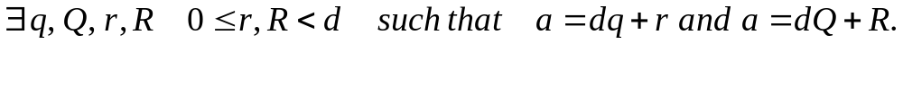
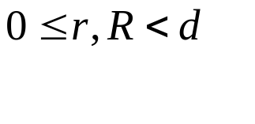
b) Uniqueness
Suppose
Without loss of generality we may assume that q ≤ Q.
Subtracting both equations we have: d (q-Q) = (R – r) (*)
So, d divides (R-r); so, either |d| ≤ |(R –r)| or (R – r) = 0.
Since –d < R - r < d (because )
i.e., |R-r| < d, we must have R – r = 0.
So, R = r.
Substituting into the original two equations,
we have dq = d Q (note d≠0) and thus q=Q, proving uniqueness.
(or directly from (*))
QED

Slide 15
Modular arithmetic
If a and b are integers and m is a positive integer, then
“a is congruent to b modulo m” if m divides a-b
  Notation: a ≡ b (mod m)
  Rephrased: m | a-b
  Rephrased: a mod m = b mod m
  If they are not congruent: a ≡ b (mod m)
Example: Is 17 congruent to 5 modulo 6?
  Rephrased: 17 ≡ 5 (mod 6)
  As 6 divides 17-5, they are congruent
Example: Is 24 congruent to 14 modulo 6?
  Rephrased: 24 ≡ 14 (mod 6)
  As 6 does not divide 24-14 = 10, they are not congruent
Note “=“ sign.
  Note: this is a different use of “≡” than the meaning “is defined as” used before.

Slide 16
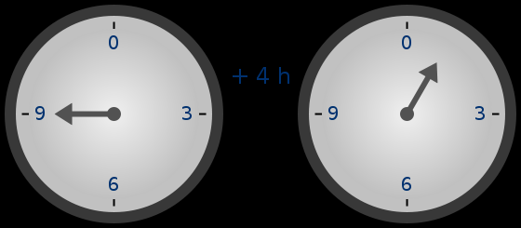
Time-keeping on a clock gives an example of modular arithmetic.
(mod 12 in the US;
or mod 24, using the 24hr clock.
Naturally imposed by the periodicity of earth’s rotation.)

Slide 17

Spiral Visualization of mod
Where is -1?
Where is -7?
The spiral/circular view is useful
to keep in mind when doing
modular arithmetic!
Example shown:
modulo-5
arithmetic
≡ 0
(mod 5)
20
15
≡ 1
(mod 5)
10
≡ 4
(mod 5)
19
5
21
14
9
16
4
0
6
11
1
Congruence classes
modulo 5.
3
2
8
7
13
12
18
17
22
≡ 3
(mod 5)
≡ 2
(mod 5)
Collapses infinite
set of numbers into
5 classes.
So, e.g., 19 is congruent to 9 modulo 5.
Notes:
Do another example on the board.

Slide 18
More on congruences
Theorem: Let a and b be integers, and let m be a positive integer.
Then a ≡ b (mod m) if and only if a mod m = b mod m
Theorem:
Let m be a positive integer. The integers a and b are congruent modulo m if and only if there is an integer k such that a = b + km
Example: 17 and 5 are congruent modulo 6, so
  17 = 5 + 2*6
  5 = 17 - 2*6

Slide 19
Even even more on congruence
Theorem: Let m be a positive integer. If a ≡ b (mod m) and c ≡ d (mod m),
then a+c ≡ (b+d) (mod m) and ac ≡ bd (mod m)
Example
  We know that 7 ≡ 2 (mod 5) and 11 ≡ 1 (mod 5)
  Thus, 7+11 ≡ (2+1) (mod 5), or 18 ≡ 3 (mod 5)
  Thus, 7*11 ≡ 2*1 (mod 5), or 77 ≡ 2 (mod 5)

Slide 20
Applications of Congruences

Slide 21
Hashing Functions
Also known as:
  hash functions, hash codes, or just hashes.
Two major uses:
  Indexing hash tables
    Data structures which support O(1)-time access.
  Creating short unique IDs for long documents.
    Used in digital signatures – the short ID can be signed, rather than the long document.

Slide 22
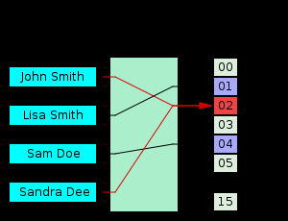
Hash Functions
Example: Consider a a record that is identified by the SSN (9 digits) of the customer or customer name itself (mapped into binary number).
How can we assign a memory location to a record so that later on it’s easy to locate and retrieve such a record?
Solution to this problem → a good hashing function.
Records are identified using a key (k), which uniquely identifies each record.
If you compute the hash of the same data at different times, you should get the same answer – if not then the data has been modified.

Slide 23
Hash Function Requirements
A hash function h: A→B is a map from a set A to a smaller set B
(i.e., |A| ≥ |B|).
An effective hash function should have the following properties:
  It should cover (be onto) its codomain B.
  It should be efficient to calculate.
  The cardinality of each pre-image of an element of B should be about the same.
    ∀b₁,b₂∈B: |h⁻¹(b₁)| ≈ |h⁻¹(b₂)|
    That is, elements of B should be generated with roughly uniform probability.
  Ideally, the map should appear random, so that clearly “similar” elements of A are not likely to map to the same (or similar) elements of B.

Slide 24
Why are these important?
To make computations fast and efficient.
So that any message can be hashed.
To prevent a message being replaced with another with the same hash value.
To prevent the sender claiming to have sent x₂ when in fact the message was x_{1.}

Slide 25
Hash Function Requirements
Furthermore, for a cryptographically secure hash function:
  Given an element b∈B, the problem of finding an a∈A such that h(a)=b should have average-case time complexity of Ω(|B|^{c}) for some c>0.
    This ensures that it would take exponential time in the length of an ID for an opponent to “fake” a different document having the same ID.

Slide 26
A Simple Hash Using mod
Let the domain and codomain be the sets of all natural numbers below certain bounds:
  A = {a∈N | a < a_{lim}}, B = {b∈N | b < b_{lim}}
Then an acceptable (although not great!) hash function from A to B (when a_{lim}≥b_{lim}) is
h(a) = a mod b_{lim}.
It has the following desirable hash function properties:
  It covers or is onto its codomain B (its range is B).
  When a_{lim} ≫ b_{lim}, then each b∈B has a preimage of about the same size,
    Specifically, |h⁻¹(b)| = ⎣a_{lim}/b_{lim}⎦ or ⎡a_{lim}/b_{lim}⎤.

Slide 27
A Simple Hash Using mod
  However, it has the following limitations:
    It is not very random. Why not?
    It is definitely not cryptographically secure.
      Given a b, it is easy to generate a’s that map to it. How?
For example, if all a’s encountered happen to have the same residue mod b_{lim}, they will all map to the same b!
(see also “spiral view”) But ok, if input data is uniformly distributed.
        We know that for any n∈N, h(b + n b_{lim}) = b.

Slide 28
Collision
Because a hash function is not one-to-one (there are more possible keys than memory locations) more than one record may be assigned to the same location → we call this situation a collision.
What to do when a collision happens?
One possible way of solving a collision is to assign the first free location following the occupied memory location assigned by the hashing function.
There are other ways… for example chaining
(At each spot in the hash table, keep a linked list of keys sharing this hash value, and do a sequential search to find the one we need. )
Notes:
Put it somewhere else! - In open addressing, we have a rule to decide where to put it if the space is already occupied.
Keep a list at each bin! - At each spot in the hash table, keep a linked list of keys sharing this hash value, and do a sequential search to find the one we need. This method is called chaining.
Collision Resolution by Chaining
The easiest approach is to let each element in the hash table be a pointer to a list of keys.
Insertion, deletion, and query reduce to the problem in linked lists. If the n keys are distributed uniformly in a table of size m/n, each operation takes O(m/n) time.
Chaining is easy, but devotes a considerable amount of memory to pointers, which could be used to make the table larger. Still, it is my preferred method.
Open Addressing
We can dispense with all these pointers by using an implicit reference derived from a simple function:
If the space we want to use is filled, we can examine the remaining locations:
Sequentially
Quadratically
Linearly

Slide 29
Digital Signature Application
Many digital signature systems use a cryptographically secure (but public) hash function h which maps arbitrarily long documents down to fixed-length (e.g., 1,024-bit) “fingerprint” strings.
Document signing procedure:
Signature verification procedure:
  Given a document a to sign, quickly compute its hash b = h(a).
  Compute a certain function c = f(b) that is known only to the signer
    This step is generally slow, so we don’t want to apply it to the whole document.
  Deliver the original document together with the digital signature c.
  Given a document a and signature c, quickly find a’s hash b = h(a).
  Compute b′ = f ⁻¹(c). (Possible if f’s inverse f ⁻¹ is made public (but not f ☺).)
  Compare b to b′; if they are equal then the signature is valid.
What if h was not cryptographically secure?
Note that if h were not cryptographically secure, then an opponent could easily forge a different document a′ that hashes to the same value b, and thereby attach someone’s digital signature to a different document than they actually signed, and fool the verifier!

Slide 30
Pseudorandom numbers

Slide 31
Pseudorandom numbers
Computers cannot generate truly random numbers – that’s why we call them pseudo-random numbers!
Linear Congruential Method: Algorithm for generating pseudorandom numbers.
Choose 4 integers
  Seed x₀: starting value
  Modulus m: maximum possible value
  Multiplier a: such that 2 ≤ a < m
  Increment c: between 0 and m
In order to generate a sequence of pseudorandom numbers, {x_{n} | 0≤ x_{n} <m}, apply the formula:
x_{n+1} = (ax_{n} + c) mod m

Slide 32
Pseudorandom numbers
Formula: x_{n+1} = (ax_{n} + c) mod m
Let x₀ = 3, m = 9, a = 7, and c = 4
x₁ = 7x₀+4 = 7*3+4 = 25 mod 9 = 7
x₂ = 7x₁+4 = 7*7+4 = 53 mod 9 = 8
x₃ = 7x₂+4 = 7*8+4 = 60 mod 9 = 6
x₄ = 7x₃+4 = 7*6+4 = 46 mod 9 = 1
x₅ = 7x₄+4 = 7*1+4 = 11 mod 9 = 2
x₆ = 7x₅+4 = 7*2+4 = 18 mod 9 = 0
x₇ = 7x₆+4 = 7*0+4 = 4 mod 9 = 4
x₈ = 7x₇+4 = 7*4+4 = 32 mod 9 = 5
Quite random!

Slide 33
Pseudorandom numbers
Formula: x_{n+1} = (ax_{n} + c) mod m
Let x₀ = 3, m = 9, a = 7, and c = 4
This sequence generates:
3, 7, 8, 6, 1, 2, 0, 4, 5, 3 , 7, 8, 6, 1, 2, 0, 4, 5, 3
  Note that it repeats!
  But it selects all the possible numbers before doing so
The common algorithms today use m = 2³²-1
  You have to choose 4 billion numbers before it repeats
Multiplier 7⁵ = 16,807 and increment c = 0 (pure multiplicative generator)

Slide 34
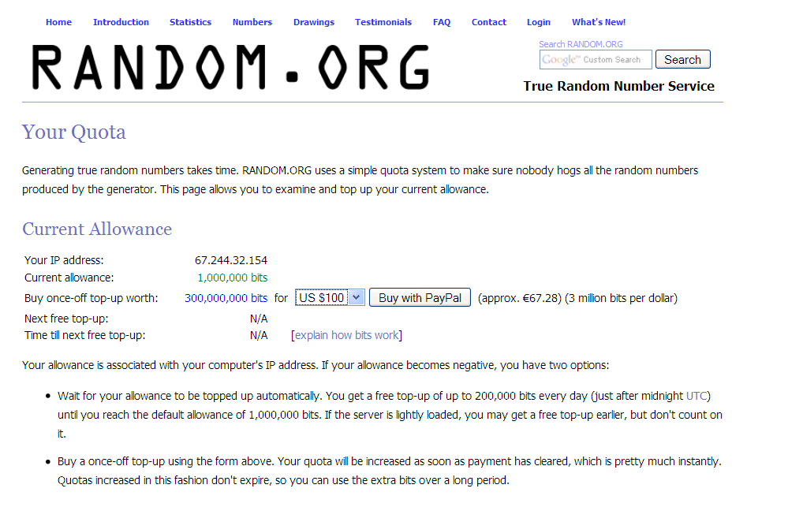
3 million random bits per dollar
Quite a bargain…

Slide 35
Cryptology
(secret messages)

Slide 36
The Caesar cipher
Julius Caesar used the following procedure to encrypt messages
A function f to encrypt a letter is defined as:
f(p) = (p+3) mod 26
  Where p is a letter (0 is A, 1 is B, 25 is Z, etc.)
Decryption: f⁻¹(p) = (p-3) mod 26
This is called a substitution cipher
  You are substituting one letter with another

Slide 37
The Caesar cipher
Encrypt “go cavaliers”
  Translate to numbers: g = 6, o = 14, etc.
    Full sequence: 6, 14, 2, 0, 21, 0, 11, 8, 4, 17, 18
  Apply the cipher to each number: f(6) = 9, f(14) = 17, etc.
    Full sequence: 9, 17, 5, 3, 24, 3, 14, 11, 7, 20, 21
  Convert the numbers back to letters 9 = j, 17 = r, etc.
    Full sequence: jr wfdydolhuv
Decrypt “jr wfdydolhuv”
  Translate to numbers: j = 9, r = 17, etc.
    Full sequence: 9, 17, 5, 3, 24, 3, 14, 11, 7, 20, 21
  Apply the cipher to each number: f⁻¹(9) = 6, f⁻¹(17) = 14, etc.
    Full sequence: 6, 14, 2, 0, 21, 0, 11, 8, 4, 17, 18
  Convert the numbers back to letters 6 = g, 14 = 0, etc.
    Full sequence: “go cavaliers”

Slide 38
Rot13 encoding
A Caesar cipher, but translates letters by 13 instead of 3
  Then, apply the same function to decrypt it, as 13+13=26
Rot13 stands for “rotate by 13”
Example:
  >echo Hello World | rot13
  Uryyb Jbeyq
  > echo Uryyb Jbeyq | rot13
  Hello World

Slide 39
Primes and Greatest Common Divisor

Slide 40
Prime numbers
A positive integer p is prime if the only positive factors of p are 1 and p
  If there are other factors, it is composite
  Note that 1 is not prime!
    It’s not composite either – it’s in its own class
An integer n is composite if and only if there exists an integer a such that a | n and 1 < a < n

Slide 41
Fundamental theorem of arithmetic
Fundamental Theorem of Arithmetic:
Every positive integer greater than 1 can be uniquely written as a prime or as
the product of two or more primes where the prime factors are written in
order of non-decreasing size
Examples
  100 = 2 * 2 * 5 * 5
  182 = 2 * 7 * 13
  29820 = 2 * 2 * 3 * 5 * 7 * 71
In a fundamental sense, primes are the building blocks of the natural numbers.

Slide 42
Fundamental theorem of arithmetic:
Strong Induction
[from before]
Show that if n is an integer greater than 1, then n can be written as the product of primes.
1 - Hypothesis P(n) - n can be written as the product of primes.
2 – Base case – P(2) 2 can be written a 2 (the product of itself)
3 – Inductive Hypothesis - P(j) is true for ∀ 2 ≤j ≤k, j integer.
4 – Inductive step?
a) k+1 is prime – in this case it’s the product of itself;
b) k+1 is a composite number and it can be written as the product of two positive integers a and b, with 2 ≤a ≤ b ≤ k+1. By the inductive hypothesis, a and b can be written as the product of primes, and so does k+1 ,
What’s missing?
Uniqueness proof,
soon…
QED

Slide 43
Composite factors
Theorem: If n is a composite integer, then n has a prime divisor less than or equal to the square root of n
Proof
  Since n is composite, it has a factor a such that 1<a<n
  Thus, n = ab, where a and b are positive integers greater than 1
  Either a≤√n or b≤√n (Otherwise, assume a > √n and b > √n, then
  ab > √n*√n > n. Contradiction.)
  Thus, n has a divisor not exceeding √n
  This divisor is either prime or a composite
    If the latter, then it has a prime factor (by the FTA)
  In either case, n has a prime factor less than √n
QED

Slide 44
Showing a number is prime
E.g., show that 113 is prime.
Solution
  The only prime factors less than √113 = 10.63 are 2, 3, 5, and 7
  None of these divide 113 evenly
  Thus, by the fundamental theorem of arithmetic, 113 must be prime
How?

Slide 45
Showing a number is composite
Show that 899 is composite.
Solution
  Divide 899 by successively larger primes, starting with 2
  We find that 29 and 31 divide 899

Slide 46
On a linux system or in cygwin, enter “factor 899”
  > factor 899
  899: 29 31
  >factor 89999999999999999
  89999999999999999: 7 7 13 6122449 23076923

Slide 47
Some “random” numbers factored (using “factor”)
12304: 2 2 2 2 769
12304038495: 3 5 7 3109 37691
29485404038495: 5 5897080807699
294854040334945723: 67 2472061 1780217629
29485404033420344: 2 2 2 1109 3323422456427
294854043485472: 2 2 2 2 2 3 151 173 117574409
29485404203484: 2 2 3 101 103 229 1031411
9348492404203484: 2 2 7 23 14516292553111
928439237492742742: 2 13 89 10453 12821 2993831
9284392329378472: 2 2 2 31321 37053384029
9284392329378472323: 3 3 3 307 1120085936708707
Hmm. Apparent pattern of a several small prime factors ending with one or two
very large primes. Real? Still many mysteries in prime number patterns…
Open questions about exact distribution of primes closely related to the main
open problem in math: the Riemann hypothesis concerning distr. of zeros of
the Riemann zeta-function.

Slide 48
Theorem: There are infinitely many primes.
See our earlier proof by contradiction.

Slide 49
Mersenne numbers
Mersenne number: any number of the form 2^{n}-1
Mersenne prime: any prime of the form 2^{p}-1, where p is
also a prime
  Example: 2⁵-1 = 31 is a Mersenne prime
  But 2¹¹-1 = 2047 is not a prime (23*89) ☹
If M is a Mersenne prime, then M(M+1)/2 is a perfect number
  A perfect number equals the sum of its divisors
  Example: 2³-1 = 7 is a Mersenne prime, thus 7*8/2 = 28 is a perfect number
    28 = 1+2+4+7+14
  Example: 2⁵-1 = 31 is a Merenne prime, thus 31*32/2 = 496 is a perfect number
496 = 2*2*2*2*31 ➔ 1+2+4+8+16+31+62+124+248 = 496

Slide 50
The largest primes found are Mersenne primes.
Since, 2^{p}-1 grows fast, and there is a quite efficient test – Lucas-Lehmer test – for determining if a Mersenne prime is prime.

Slide 51
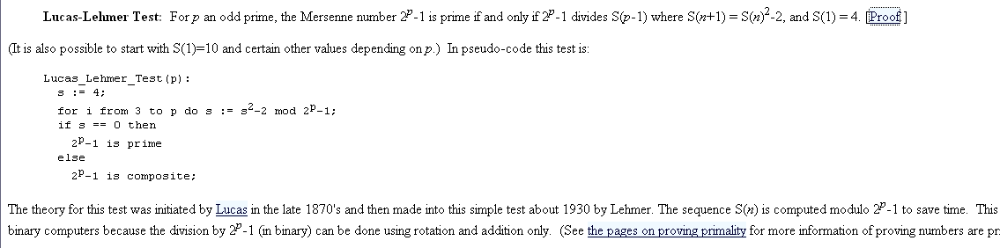
Lucas-Lehmer test

Slide 52
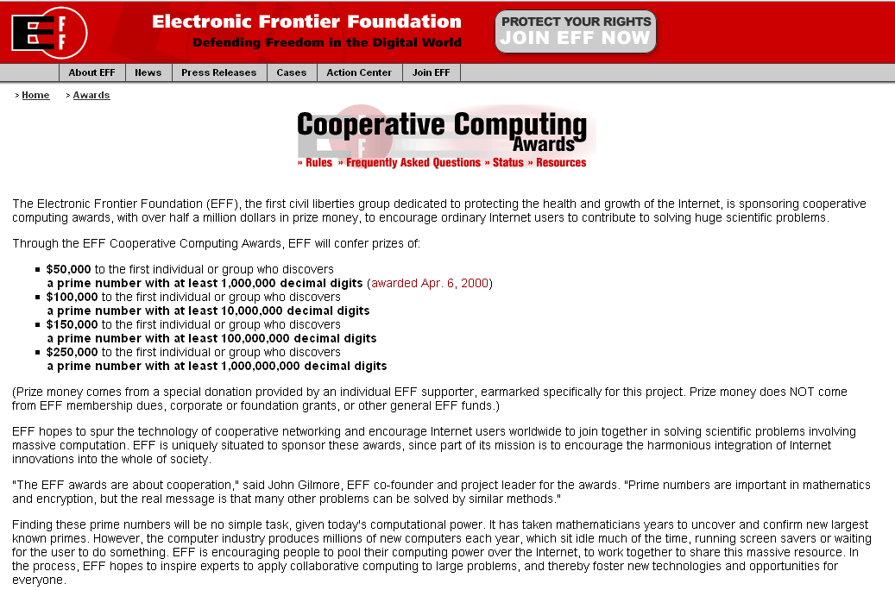

Slide 53
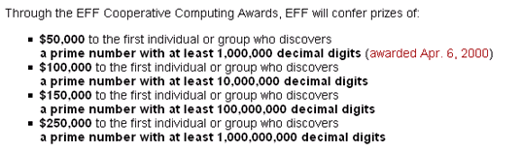
So, there’s still some easy cash to be made! ☺

Slide 54
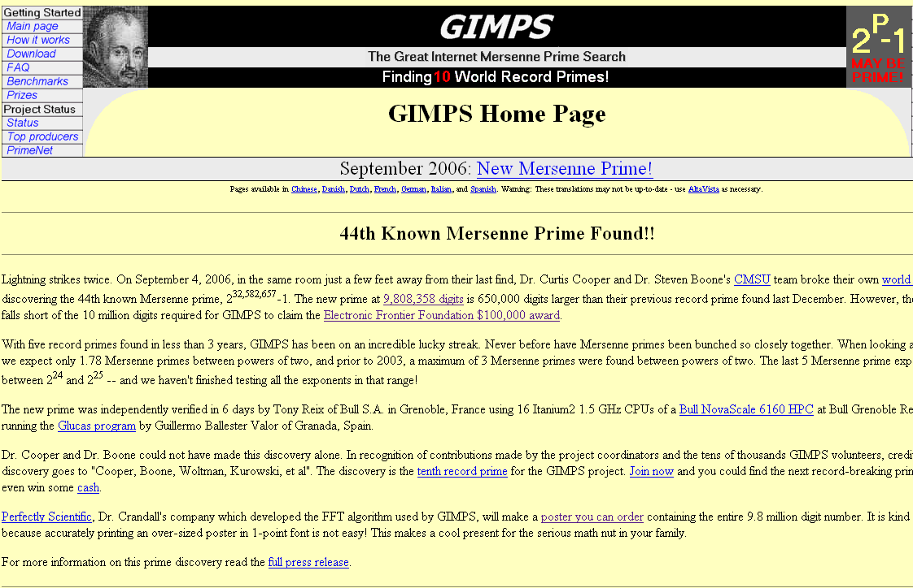
9,808,358 digits… that’s close! ☹

Slide 55
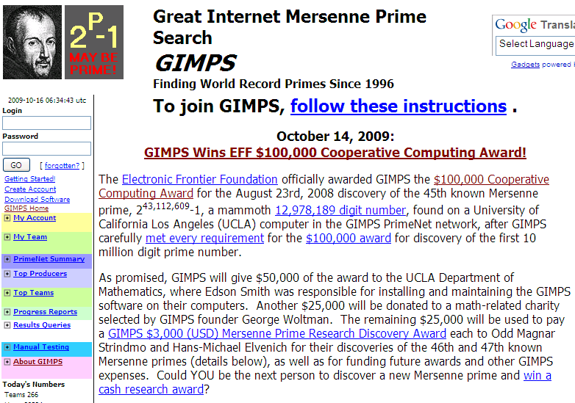
12M digit prime found! Prize awarded Oct. 14!

Slide 56
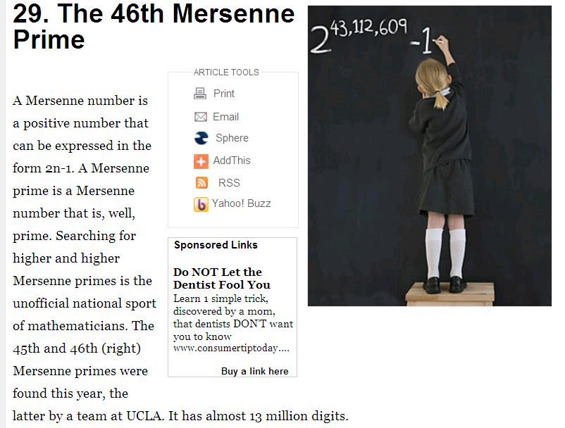
TIME’s Best Inventions of 2008.

Slide 57
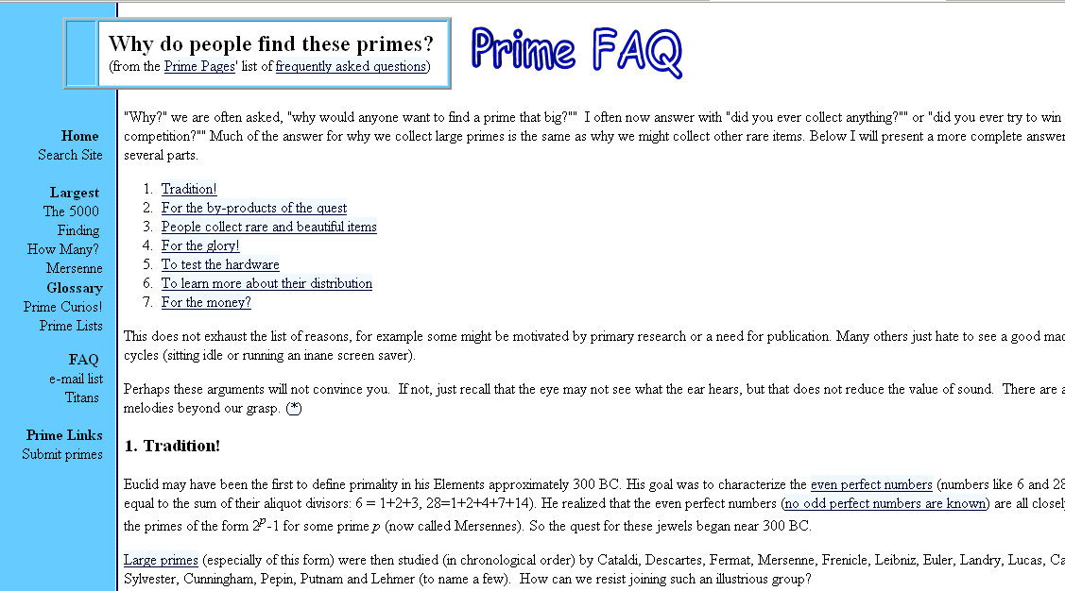
Also, what special patterns are there (if any) in the digits of prime numbers?

Slide 58
The prime number theorem
The ratio of the number of primes not exceeding x and x/ln(x) approaches 1 as x grows without bound
  Rephrased: the number of prime numbers less than x is approximately x/ln(x)
  (in 1792 by Gauss at 15...)
  Rephrased: the chance of an number x being a prime number is (roughly) 1 / ln(x)
(density: there are n numbers up to n with roughly n/ln(n)
being prime. So, frequency of primes among n numbers is around 1/ln(n).)
  So, less frequent for higher x
  But still, there are many primes!! (key for crypto!!)
Consider 200 digit prime numbers
  ln (10²⁰⁰) ≈ 460
  The chance of a 200 digit number being prime is 1/460
  If we only choose odd numbers, the chance is 2/460 = 1/230

Slide 59
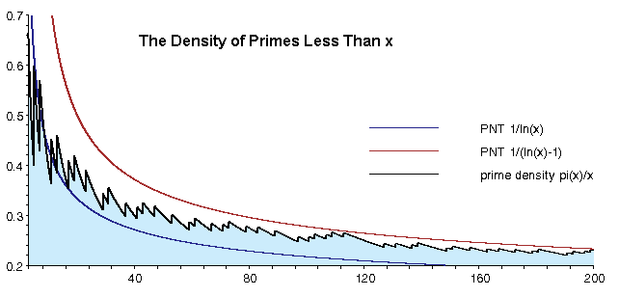

Slide 60
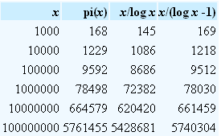
So, actually x /(ln x – 1) is better estimate of number of primes.

Slide 61
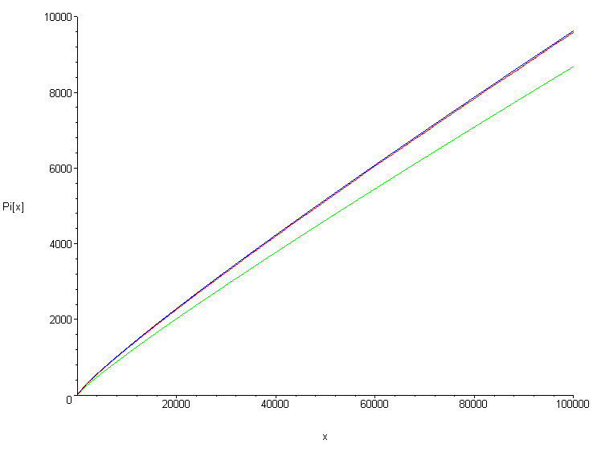


Slide 62
Greatest common divisor
The greatest common divisor of two integers a and b is the largest integer d such that d | a and d | b
  Denoted by gcd(a,b)
Examples
  gcd (24, 36) = 12
  gcd (17, 22) = 1
  gcd (100, 17) = 1

Slide 63
Relative primes
Two numbers are relatively prime if they don’t have any common factors (other than 1)
  Rephrased: a and b are relatively prime if
  gcd (a,b) = 1
gcd (25, 16) = 1, so 25 and 16 are relatively prime

Slide 64
Pairwise relative prime
A set of integers a₁, a₂, … a_{n} are pairwise relatively prime if, for all pairs of numbers, they are relatively prime
  Formally: The integers a₁, a₂, … a_{n} are pairwise relatively prime if gcd(a_{i}, a_{j}) = 1 whenever 1 ≤ i < j ≤ n.
Example: are 10, 17, and 21 pairwise relatively prime?
  gcd(10,17) = 1, gcd (17, 21) = 1, and gcd (21, 10) = 1
  Thus, they are pairwise relatively prime
Example: are 10, 19, and 24 pairwise relatively prime?
  Since gcd(10,24) ≠ 1, they are not

Slide 65
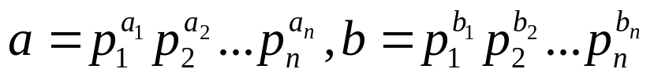
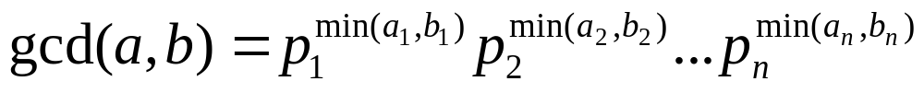
More on gcd’s
Given two numbers a and b, rewrite them as:
  Example: gcd (120, 500)
    120 = 2³*3*5 = 2³*3¹*5¹
    500 = 2²*5³ = 2²*3⁰*5³
Then compute the gcd by the following formula:
  Example: gcd(120,500) = 2^{min(3,2)} 3^{min(1,0)} 5^{min(1,3)} = 2² 3⁰ 5¹ = 20

Slide 66
Least common multiple
The least common multiple of the positive integers a and b is the smallest positive integer that is divisible by both a and b.
  Denoted by lcm (a, b)
Example: lcm(10, 25) = 50
What is lcm (95256, 432)?
  95256 = 2³3⁵7², 432=2⁴3³
  lcm (2³3⁵7², 2⁴3³) = 2^{max(3,4)}3^{max(5,3)}7^{max(2,0)}
  = 2⁴ 3⁵ 7² = 190512

Slide 67
lcm and gcd theorem
Theorem: Let a and b be positive integers.
Then a*b = gcd(a,b) * lcm (a, b)
Example: gcd (10,25) = 5, lcm (10,25) = 50
  So, 10*25 = 5*50
Example: gcd (95256, 432) = 216, lcm (95256, 432) = 190512
  So, 95256*432 = 216*190512
(likely)
Exp. in # of digits! ☹
Two algs.:
Try all #s up to smallest
Factor #s.
How do we find the gcd?

Slide 68
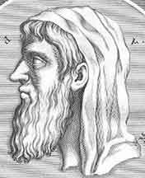
Euclid’s Algorithm for GCD
Finding GCDs by comparing prime factorizations can be difficult when the prime factors are not known! And, no fast alg. for factoring is known. (except …)
Euclid discovered: For all ints. a, b
gcd(a, b) = gcd((a mod b), b).
How can this be useful? (assume a>b)
Sort a, b so that a>b, and then (given b>1)
(a mod b) < a, so problem is simplified.
On quantum computer!
Euclid of
Alexandria
325-265 B.C.

Slide 69
Theorem: Let a =bq+r, where a, b, q, and r are integers.
Then gcd(a,b) = gcd(b,r)
Suppose a and b are the natural numbers whose gcd has to be
determined. And suppose the remainder of the division of a by b is r.
Therefore a = qb + r where q is the quotient of the division.
Any common divisor of a and b is also a divisor of r. To see why this is
true, consider that r can be written as r = a − qb. Now, if there is a
common divisor d of a and b such that a = sd and b = td, then
r = (s−qt)d. Since all these numbers, including s−qt, are whole
numbers, it can be seen that r is divisible by d. (Also, by corollary
on slide 6.)
Similarly, any common divisor of b and r is also a divisor of a. Note that
a = qb +r. Hence a common divisor of b and r also divides a.
It follows that gcd(a,b) = gcd(b,r).
QED

Slide 70
Euclidean Algorithm
Lemma: Let a = bq + r, where a, b, q, and r are
integers. Then gcd(a, b) = gcd(b, r)
procedure procedure (a,b:positive integers)
x := a
y := b
while y ≠ 0
begin
r := x mod y
x := y
y := r
end { gcd(a, b) is x }
Arises when r = 0. So, y divides x. But “x:=y” and “y:=0”, so return x. Also
note that gcd(a,0) = a.
What about the “y=0” case?
Do we need a >= b? hmm…

Slide 71
Euclid’s Algorithm Example
gcd(372,164) = gcd(164, 372 mod 164).
  372 mod 164 = 372−164 ⎣372/164⎦ = 372−164·2 = 372−328 = 44.
gcd(164,44) = gcd(44, 164 mod 44).
  164 mod 44 = 164−44 ⎣164/44⎦ = 164−44·3 = 164−132 = 32.
gcd(44,32) = gcd(32, 44 mod 32)
= gcd(32,12) = gcd(12, 32 mod 12)
= gcd(12,8) = gcd(8, 12 mod 8)
= gcd(8,4) = gcd(4, 8 mod 4)
= gcd(4,0) = 4.
2000+ yr alg. makes
E-commerce possible!
So, we repeatedly swap the numbers. Largest first. “mod” reduces
them quickly!
O(log b) divisions. Linear in #digits of b!
Compare to direct search for divisor.
Complexity? Guess…
(Lame`’s thm. Section 4.3)

Slide 72
Integers and Algorithms

Slide 73
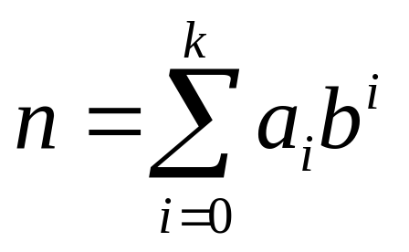
Base-b number systems
Ordinarily, we write base-10 representations of numbers, using digits 0-9.
Of course, any base b>1 will work.
For any positive integers n,b, there is a unique sequence
a_{k} a_{k-1}… a₁a₀ of digits a_{i}<b such that:
Hmm. What about base 1?
Unary notation; “mainly” quite inefficient.
Why bother with “unary”?
Complexity of algs.:
always think about, what
is the length of the input.
Some problems still
hard even with unary input!
The “base b expansion
of n”
Notes:
We’ll deal with summation notation in detail later. For now, explain what it means in this particular case.

Slide 74
Base Systems
Theorem: Base b expansion of a number
Let b be a positive integer greater than 1. Then if n is a positive integer, it can be expressed uniquely in the form
n = a_{k} b_{k} ^k + a_{k-1} b_{k-1} ^(k-1)+ … + a₁ b^1 + a₀
Where k is a non-negative integer, a₀, a₁, …, a_{k} are nonnegative integers less than b, and a_{k} ≠0
(Proof by induction)

Slide 75
Bases of Particular Interest
Used “only” because we have 10 fingers
Base b=10 (decimal):
10 digits: 0,1,2,3,4,5,6,7,8,9.
Base b=2 (binary):
2 digits: 0,1. (“Bits”=“binary digits.”)
Base b=8 (octal):
8 digits: 0,1,2,3,4,5,6,7.
Base b=16 (hexadecimal):
16 digits: 0,1,2,3,4,5,6,7,8,9,A,B,C,D,E,F
The modern
digital world!
Octal digits correspond to groups of 3 bits
Hex digits give groups of 4 bits

Slide 76
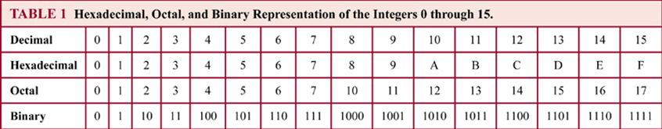

Slide 77
Converting to Base b
(An algorithm, informally stated.)
To convert any integer n to any base b>1:
To find the value of the rightmost (lowest-order) digit, simply compute n mod b.
Now, replace n with the quotient ⎣n/b⎦.
Repeat above two steps to find subsequent digits, until n is gone (=0).
Notes:
Have students write out pseudocode in class?

Slide 78
Constructing Base b Expansions
procedure base b expansion (n:positive integer)
q := n
k := 0
while (q ≠ 0)
begin
a_{k} := q mod b
q := ⎣ q / b ⎦
k := k + 1
end {the base b expansion of n is (a_{k-1} a_{k-2} . . . a₁ a₀ )_{b} }

Slide 79
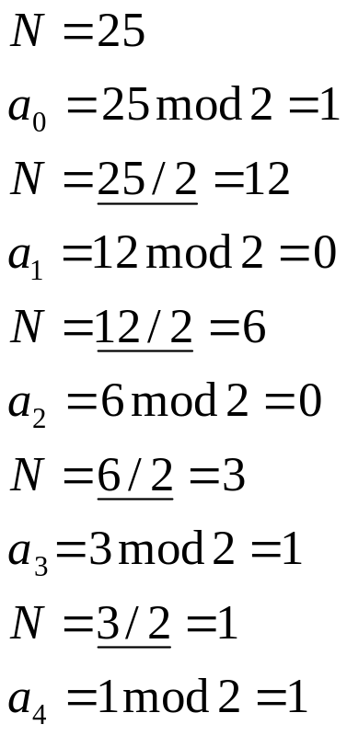
N=25 in binary?
So, we have 25 in binary
is 11001.

Slide 80
N= 23670 in hexadecimal?
23670 mod 16 = 6; 6
N= ⎣ 23670/16 ⎦ = 1479 mod 16 = 7 76
N= ⎣ 1479/16 ⎦ = 92 mod 16 = 12 C76
N= ⎣92/16 ⎦ = 5 mod 16 = 5 5C76

Slide 81
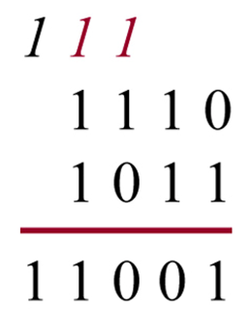
Addition of Integers in Binary Notation
As you have known since grade 1 or before … ☺
Correctness proof?
procedure add (a,b:positive integers)
c := 0
for j := 0 to n - 1
begin
d := ⎣ (a_{j} + b_{j} + c) / 2 ⎦
s_{j} := a_{j} + b_{j} + c - 2d
c := d
end
s_{j} := c
{the binary expansion of the sum is (s_{n} s_{n-1} . . . s₀ )₂ }
Complexity? (#additions)
O(n),
where n is number of bits!
(log of the size of the number)
{the binary expansions of a and b are:
a_{n-1},a_{n-2},… a₁,a₀ and
b_{n-1},b_{n-2},… b₁,b₀}

Slide 82
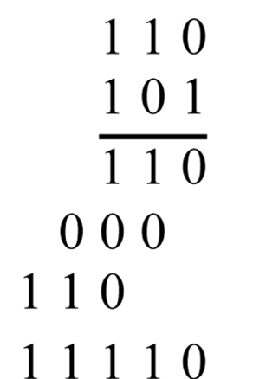
Multiplying Integers
procedure multiply (a,b:positive integers)
c := 0
for j := 0 to n - 1
begin
if b_{j} then c_{j} := a shifted j places
else c_{j} := 0
end
p := 0
for j := 0 to n – 1
p := p + c_{j}
{p is the value of ab }
Complexity? (additions and shifts)
O(n²)
{the binary expansions of a and b are:
a_{n-1},a_{n-2},… a₁,a₀ and
b_{n-1},b_{n-2},… b₁,b₀}
Note: There are more efficient algorithms for multiplication!

Slide 83
Modular Exponentiation
Problem: Given large integers b (base), n (exponent), and m (modulus), efficiently compute b^{n} mod m.
  Note that b^{n} itself may contain a very large number of digits.
Yet, this is a type of calculation that is commonly required in modern cryptographic algorithms! Hmm.

Slide 84
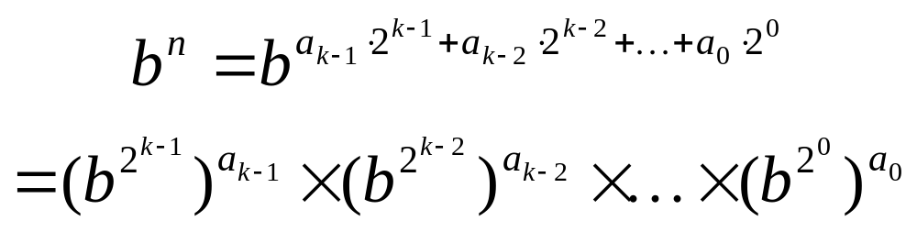
Modular Exponentiation:
Using Binary Expansion of exponent n
The binary expansion of n
Note that:
We can compute b to various powers of 2 by repeated squaring.
  Then multiply them into the partial product, or not, depending on
  whether the corresponding a_{i} bit is 1.
Problem solved?
Crucially, we can do the mod m operations as we go along, because of the various identity laws of modular arithmetic.
– All the numbers stay small.

Slide 85

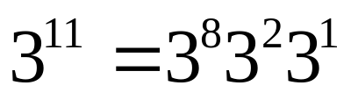
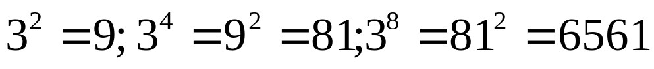
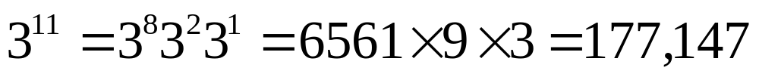
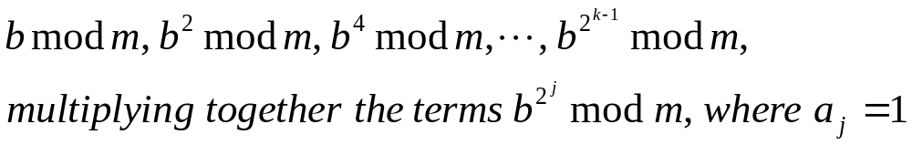
Example:
Note: 11 = (1011)₂
So,
By successively squaring:
Therefore:
The algorithm successively computes:

Slide 86
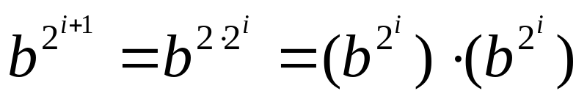
Modular Exponentiation
procedure modular exponentiation (b:integer, a_{k−1} a_{k−2} …a₀:binary representation of n, m: positive integer)
x := 1
power := b mod m
for i := 0 to k−1
begin
if a_{i} = 1 then x := (x．power) mod m
power := (power．power) mod m
end
return x

Slide 87
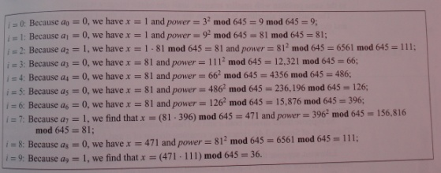
Example: 3⁶⁴⁴ mod 645
Note: 644 = (1010000100)₂
Steps performed by the algorithm:
Aside: 3⁶⁴⁴ is HUGE but final
answer between 0 and 644. ☺
So , 3⁶⁴⁴ mod 645 = 36.
Key point: you compute successive powers but numbers
stay small because of repeated Mod operation!

Slide 88
Two Additional Applications:
1 - Performing arithmetic with large numbers
2 - Public Key System
→ require some additional results in Number Theory

Slide 89
Additional Number Theory Results
Theorem:
  ∀a,b integers, a,b >0: ∃s,t: gcd(a,b) = sa + tb
Lemma 1:
  ∀a,b,c>0: gcd(a,b)=1 and a | bc, then a|c
Lemma 2:
  If p is prime and p|a₁a₂…a_{n} (integers a_{i}),
  then ∃i: p|a_{i}.
Theorem 2:
  If ac ≡ bc (mod m) and gcd(c,m)=1,
  then a ≡ b (mod m).

Slide 90
Proof of Theorem 1
Theorem 1: ∀a≥ b≥ 0 ∃st: gcd(a,b) = sa + tb
Proof: By induction over the value of the larger argument a.
Note: From Euclid theorem (“reducing the size of a”), we know that gcd(a,b) =
gcd(b,c) with c = a mod b, in which case a = kb +c for some integer k,
so c = a − kb.
With b < a and c < b (see base case below for boundary cases), by the inductive
hypothesis (strong induction), we can assume that ∃uv: gcd(b,c) = ub +vc.
Substituting for c, this is ub+v(a−kb), which we can
regroup to get va + (u−vk)b. So, now let s = v, and let t = u−vk, and we’re done with
induction step.
Base case?
The base case is solved by considering: s = 1, t = 0, which works for gcd(a,0),
or if a=b originally (also handles gcd(0,0)).
QED

Slide 91
Example:
gcd(252,198) = 18.
Let’s express 18 as a linear combination of 252 and 198.
Using the divisions performed by the Euclid Algorithm:
252 = 1× 198 + 54 (from 252 mod 198 = 54)
198 = 3 × 54 + 36 (from 198 mod 54 = 36)
54 = 1 × 36 +18 etc.
36 = 2 × 18
So, 18 = 54 - 1 × 36 (from 3rd equation)
36 = 198 – 3 × 54 (from 2th equation)
Therefore 18 = 54 - 1 × (198 – 3 × 54) = 4 × 54 – 1 × 198
But 54 = 252 - 1× 198; so substituting this expression for 54:
18 = 4 (252 - 1× 198) - 1 × 198 = 4 × 252 – 5 × 198
So, gcd(252,198) = 18 = 4 x 252 – 5 x 198.
I.e., the gcd is a linear combination of the original numbers.
Intriguing property of the gcd!! One of the mulipliers has to be negative.
gcd(252,198) =
gcd(198,54) =
gcd(54,36) =
gcd(36,18) =
gcd(18,0) =
18

Slide 92
E.g.
gcd(17,5) = 1 (i.e. one argument is prime, or relative primes)
1 = -7 x 17 + 24 x 5
= 8 x 17 – 27 x 5
0, 17, 34, 51, 68, 85, 102, 119, 136 …

Slide 93
Proof of Lemma 1
Lemma 1: gcd(a,b) = 1 and a|bc, then a|c.
Proof: Applying theorem 1, ∃s, t: sa+tb = 1. Multiplying through by c,
we have that sac + tbc = c. Since a|bc is given, we know that a|tbc,
and obviously a|sac. Thus, it follows that a|(sac+tbc). So, we have
that a|c. ■
Alt. proof: Consider the prime factorization of a, b, and c.
Aside: But, why don’t we want to use this property for now?

Slide 94
Proof of Lemma 2
Lemma 2: If prime p|a₁…a_{n} then ∃i: p|a_{i}.
Proof: If n=1, this is immediate since p|a₁ then p|a₁. Suppose the lemma is true for all n<k and suppose p|a₁…a_{k}. Consider m=a₁…a_{k-1}. If p|m, then we have it inductively. Otherwise, we have p|ma_{k} but ¬(p|m). Since m is not a multiple of p, and p has no factors, m has no common factors with p, thus gcd(m,p)=1. So, by applying lemma 1, p|a_{k}. ■

Slide 95
Uniqueness of Prime Factorizations
The “other” part of proving the Fundamental Theorem of Arithmetic.
“The prime factorization of any number n is unique.”
Theorem: If p₁…p_{s} = q₁…q_{t} are equal products of two
nondecreasing sequences of primes, then s=t and p_{i} = q_{i} for all i.
Proof: Assume (without loss of generality) that all primes in
common have already been divided out, so that ∀ij: p_{i} ≠ q_{j}. But
since p₁…p_{s} = q₁…q_{t}, we have that p₁|q₁…q_{t}, since p₁·(p₂…p_{s}) =
q₁…q_{t}. Then applying lemma 2, ∃j: p₁|q_{j}. Since q_{j} is prime, it has
no divisors other than itself and 1, so it must be that p_{i}=q_{j}. This
contradicts the assumption ∀ij: p_{i} ≠ q_{j}. The only resolution is that
after the common primes are divided out, both lists of primes were
empty, so we couldn’t pick out p₁. In other words, the two lists
must have been identical to begin with!
Aside: Property is so well-known, that there is a temptation to
assume it’s “obvious”. Not so. You need the proof! If it were
false, math would be very different. (primes are the building blocks of numbers)
QED

Slide 96
Proof of Theorem 2
Theorem 2: If ac ≡ bc (mod m) and gcd(c,m)=1,
then a ≡ b (mod m).
Proof: Since ac ≡ bc (mod m), this means
m | ac−bc. Factoring the right side, we get m | c(a − b).
Since gcd(c,m)=1 (c and m are relative prime), lemma 1
implies that m | a−b, in other words, a ≡ b (mod m).
QED

Slide 97
An Application of Theorem 2
Suppose we have a pure-multiplicative pseudo-random number generator {x_{n}} using a multiplier a that is relatively prime to the modulus m.
  Then the transition function that maps from x_{n} to x_{n+1} is bijective.
    Because if x_{n+1} = ax_{n} mod m = ax_{n}′ mod m, then x_{n}=x_{n}′ (by theorem 2).
  This in turn implies that the sequence of numbers generated cannot repeat until the original number is re-encountered.
  And this means that on average, we will visit a large fraction of the numbers in the range 0 to m−1 before we begin to repeat!
    Intuitively, because the chance of hitting the first number in the sequence is 1/m, so it will take Θ(m) tries on average to get to it.
  Thus, the multiplier a ought to be chosen relatively prime to the modulus, to avoid repeating too soon.
One-to-one but why onto?
Hmm?
Can you construct a small cycle?

Slide 98
Linear Congruences, Inverses
A congruence of the form ax ≡ b (mod m) is called a linear congruence.
  To solve the congruence is to find the x’s that satisfy it.
An inverse of a, modulo m is any integer a′ such that a′a ≡ 1 (mod m).
  If we can find such an a′, notice that we can then solve ax ≡ b by multiplying
  through by it, giving a′ax ≡ a′b, thus 1·x ≡ a′b, thus x ≡ a′b (mod m).
Theorem 3:
If gcd(a,m) = 1 and m>1, then a has a unique (modulo m) inverse a′.
  Proof: By theorem 1, ∃st: sa+tm = 1, so sa+tm ≡ 1 (mod m).
  Since tm ≡ 0 (mod m), sa ≡ 1 (mod m). Thus s is an inverse of a (mod m).
  Theorem 2 guarantees that if ra ≡ sa ≡ 1 (mod m) and gcd(a,m) = 1,
  then r ≡ s (mod m). Thus this inverse is unique mod m.
  (All inverses of a are in the same congruence class as s.)
QED
Linear congruences are the basis for doing arithmetic with very large integers.

Slide 99
Example:
Find an inverse of 4 modulo 9
Since gcd(4, 9) = 1, we know that there is an inverse of 4, modulo 9.
Using the Euclidean algorithm to find the greatest common divisor :
9 = 2 × 4 + 1
So, -2× 4 + 1 × 9 = 1
Take mod 9 both sides.: -2 x 4 ≡ 1 (mod 9).
It follows that -2 is an inverse of 4 module 9.
We have: -2 x 4 = -8.
And -8 mod 9 = 1.
Also, so is every integer congruent to -2 modulo 9,
e.g., -2, 7, -11, 16, etc.

Slide 100
What are the solutions of the linear congruence 4x ≡ 5 (mod 9)?
Since we know that -2 is an inverse for 4 mod 9, we can multiply both sides of the linear congruence:
-2 × 4x ≡ -2 × 5 (mod 9)
Since -8 ≡ 1 (mod 9) and -10 ≡ 8 (mod 9), it follows that
x ≡ -10 ≡ 8 (mod 9).
(We can check that indeed, 4x ≡ 4 × 8 ≡ 5 (mod 9).)
So, solutions to the congruence are integers x such that x ≡ 8 (mod) 9,
namely, 8, 17, 26, …, and -1, -10, etc.

Slide 101
Ancient Chinese Puzzle:
There are certain things whose number is unknown. When divided by 3, the remainder is 2; when divided by 5, the remainder is 3; and when divided by 7, the remainder is 2. What is the number of things?
Stated formally:
Argh!!
What’s x such that:
x mod 3 = 2
x mod 5 = 3
x mod 7 = 2
Or, equivalently,
x ≡ 2 (mod 3)
x ≡ 3 (mod 5)
x ≡ 2 (mod 7)
Guess? ☺
x ≡ 23 (mod 105)
but how??
I.e., we have to solve a set of linear congruences.
Note you need the different “modulos” to have it
make sense.

Slide 102
Chinese Remainder Theorem
Theorem: (Chinese remainder theorem.) Let m₁,…,m_{n} > 0
be relative prime. Then the system of equations
x ≡ a_{i} (mod m_{i}) (for i=1 to n) has a unique solution
modulo m = m₁·…·m_{n}.
Proof: Let M_{i} = m/m_{i}. Thus gcd(m_{i}, M_{i})=1.
So by thm 3, ∃y_{i} such that y_{i} M_{i} ≡ 1 (mod m_{i}).
Now let x = ∑_{i} a_{i} y_{i} M_{i}.
Since m_{i} | M_{k} for k ≠ i, we have M_{k} ≡ 0 (mod m_{i}).
So, x mod m_{i} = ∑_{l} a_{l} y_{l} M_{l} mod m_{i} = a_{i} y_{i} M_{i} mod m_{i} = a_{i} mod m_{i}.
Thus, x ≡ a_{i} (mod m_{i}). Holds for each i.
Thus, the congruences hold.
(Uniqueness left as exercise.)
QED

Slide 103
What’s x such that:
x ≡ 2 (mod 3)
x ≡ 3 (mod 5)
x ≡ 2 (mod 7)?
m = m₁·…·m_{n}.
(So, a₁ = 2, etc.
and m₁ ₌ ₃ etc.)
M_{i} = m/m_{i}
y_{i} M_{i} ≡ 1 (mod m_{i}).
Using the Chinese Remainder theorem:
x = ∑_{i} a_{i} y_{i} M_{i}
m = 3×5×7 = 105
M₁ = m/3 = 105/3 = 35
2 is an inverse of M₁ = 35 (mod 3) (since 35x2 ≡ 1 (mod 3)
M₂ = m/5 = 105/5 = 21
1 is an inverse of M₂ = 21 (mod 5) (since 21x1 ≡ 1 (mod 5)
M₃ = m/7 = 15
1 is an inverse of M₃ = 15 (mod 7) (since 15x1 ≡ 1 (mod 7)
So , x ≡ 2 × 2 × 35 + 3 × 1 × 21 + 2 × 1 × 15 = 233 ≡ 23 (mod 105)
So answer: x ≡ 23 (mod 105)
We’re solving equations in modular arithmetic!!

Slide 104
Computer Arithmetic with Large Ints
By Chinese Remainder Theorem, an integer a where 0 ≤ a < m = ∏ m_{i}, gcd(m_{i},m_{j≠i}) = 1,
can be represented by a’s residues mod m_{i} as
an n-tuple: (a mod m₁, a mod m₂, …, a mod m_{n})
  Implicitly, represents the equations
  x ≡ a_{i} (mod m_{i}), with a_{i} = a mod m_{i}.
By the CRT, there is a unique solution (mod m) to these
equations. Consider x ≡ a mod m, with m = ∏ m_{i}.
Substitution shows that this x solves the equations.

Slide 105
Example:
How to represent uniquely non-integer integers less than 12 by pairs,
where the first component is the remainder of the integer upon division by
3 and the second component is the remainder of the integer upon division
by 4? (note: 3 and 4 are relative prime.)
We represent x by the tuple (x mod 3, x mod 4).
Finding the remainder of each integer divide by 3 and 4, we obtain:
0=(0,0); 1=(1,1); 2=(2,2); 3=(0,3); 4=(1,0); 5=(2,1); 6=(0,2);
7=(1,3); 8=(2,0); 9= (0,1); 10 = (1,2); 11= (2,3)
E.g. 5 = ((5 mod 3), (5 mod 4))
Note we have the right “number of pairs”, i.e., 12.
One for each number up to 4x3 -1. Also, we are using two small numbers
to represent a bigger one (up to the size of the product of the smaller
numbers.)

Slide 106
Computer Arithmetic with Large Ints
To perform arithmetic upon large integers represented in this way,
  Simply perform ops on these separate residues!
    Each of these might be done in a single machine op.
    The ops may be easily parallelized on a vector machine.
  Works so long as the desired result < m.

Slide 107
Example: Suppose we can perform operation with integers less than 100
can be done easily; we can restrict ourselves to integers less than 100, if
we represent the integers using their remainders modulo pairwise
relatively prime integers less than 100; e.g., 99, 98, 97, 95.
By the Chinese remainder theorem, any number up to
99×98 × 97 × 95 = 89,403,930 can be represented uniquely by its
remainders when divided by these four moduli.
E.g, the number
123,684 can be represented as
(123,684 mod 99; 123,684 mod 98; 123,684 mod 97; 123,684 mod 95) = (33,8,9,89)
413,456 can be represented as
(413,456 mod 99; 413,456 mod 98; 413,456 mod 97; 413,456 mod 95) = (32,92,42,16)

Slide 108
To perform a sum we only have to sum the residues:
(33, 8, 9, 89)+(32, 92 , 42, 16)
= (65 mod 99. 100 mod98, 51mod97, 105mod95)
= (65, 2, 51, 10)
To find the sum we just have to solve the system of linear congruences (see earlier slides):
x ≡ 65 (mod99)
x ≡ 2 (mod98)
x ≡ 51 (mod97)
x ≡ 10 (mod95)
Solution: 537,140

Slide 109
“Bigger” Example
For example, the following numbers are relatively prime:
  m₁ = 2²⁵−1 = 33,554,431 = 31 · 601 · 1,801
  m₂ = 2²⁷−1 = 134,217,727 = 7 · 73 · 262,657
  m₃ = 2²⁸−1 = 268,435,455 = 3 · 5 · 29 · 43 · 113 · 127
  m₄ = 2²⁹−1 = 536,870,911 = 233 · 1,103 · 2,089
  m₅ = 2³¹−1 = 2,147,483,647 (prime)
Thus, we can uniquely represent all numbers up to
m = ∏m_{i} ≈ 1.4×10⁴² ≈ 2^{139.5} by their residues r_{i} modulo these five m_{i}.
  E.g., 10³⁰ = (r₁ = 20,900,945; r₂ = 18,304,504; r₃ = 65,829,085;
  r₄ = 516,865,185; r₅ = 1,234,980,730)
To add two such numbers in this representation,
  Just add their corresponding residues using machine-native 32-bit integers.
  Take the result mod 2^{k}−1:
    If result is ≥ the appropriate 2^{k}−1 value, subtract out 2^{k}−1
  Note: No carries are needed between the different pieces!
  Do we save on space (# digits)?

Slide 110
Pseudoprimes
Recall:
Theorem: If n is a composite integer, then n has a prime divisor less than or equal to the square root of n
So to check if a number n is prime, we check if all its prime factors less than √n divide n. If not, the number is prime.
Is there a faster way of checking if a number is prime?

Slide 111
Pseudoprimes
(?)
Ancient Chinese mathematicians noticed that whenever n is prime, 2^{n−1} ≡ 1 (mod n).
  Calculate using mod exponentiation.
  Some also claimed that the converse was true.
However, it turns out that the converse is not true!
  If 2^{n−1}≡1 (mod n), it doesn’t follow that n is prime.
    For example, 341=11·31, but 2³⁴⁰ ≡ 1 (mod 341). (not so easy to find the counter example. ☺ use modular exponentiation)
Composites n with this property are called pseudoprimes.
  More generally, if b^{n−1} ≡ 1 (mod n) and n is composite, then n is called a pseudoprime to the base b.
If converse was true, what would be a great test for primality?

Slide 112
Fermat’s Little Theorem
vs. Fermat’s Last Thm.
a^n + b^n = c^n has
no solutions for n >= 3.
Fermat generalized the ancient observation that
2^{p−1}≡1 (mod p) for primes p to the following more
general theorem:
Theorem: (Fermat’s Little Theorem.)
  If p is prime and a is an integer not divisible by p, then
  a^{p−1} ≡ 1 (mod p).
  Furthermore, for every integer a
  a^{p} ≡ a (mod p).
Proof outline in ex. 17, sect. 3.7.

Slide 113
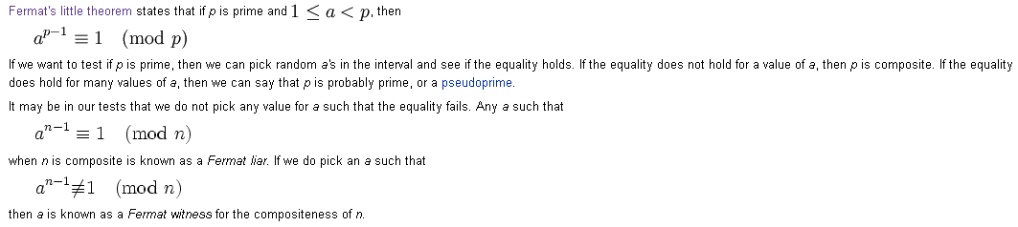
Consider: a^{p−1} ≡ 1 (mod p).
E.g., p = 5, a = 6, gives a^{p−1} ≡ 1 (mod p)
6⁴ = 1296 = 259 x 5 + 1
But, if p is NOT prime, e.g.,
p = 8, a = 6, gives a^{p−1}≡ 0 (mod p)
6⁷ = 279,936 = 34,992 * 8 + 0
What does this suggest as a primality test?

Slide 114
Carmichael numbers
These are sort of the “ultimate pseudoprimes.”
A Carmichael number is a composite n such that
a ^{n−1} ≡ 1 (mod n) for all a relatively prime to n.
The smallest few are 561, 1105, 1729, 2465, 2821, 6601, 8911, 10585, 15841, 29341.
These numbers are important since they fool the Fermat primality test:
They are “Fermat liars”.
The Miller-Rabin (’76 / ’80) randomized primality testing algorithm
eliminates problems with Carmichael problems. Polytime in number of digits!

Slide 115
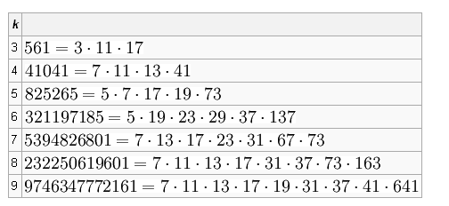

Slide 116
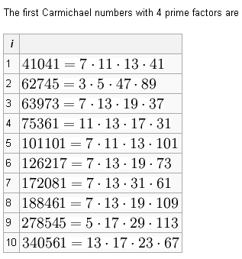

Slide 117
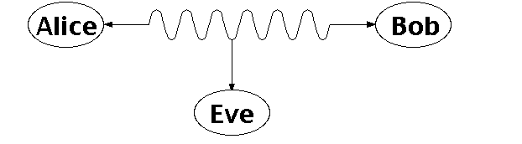
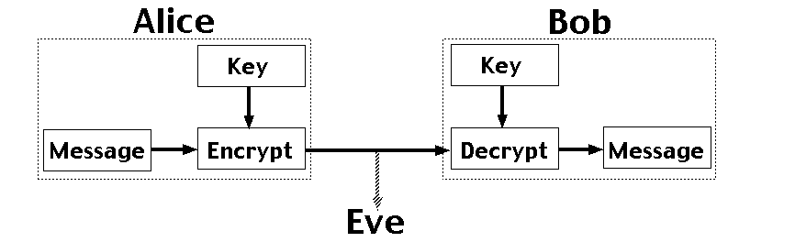
Number Theory:
RSA and Public-key Cryptography
Alice and Bob have never met but they would like to
exchange a message. Eve would like to eavesdrop.
They could come up with a good encryption algorithm and exchange the encryption key – but how to do it without
Eve getting it? (If Eve gets it, all security
is lost.)
CS folks found the solution:
public key encryption. Quite remarkable
that that is feasible.
Notes:
One solution is for Alice and Bob to exchange a digital key, so they both know it, but it's otherwise secret. Alice uses this key to encrypt messages she sends, and Bob reconstructs the original messages by decrypting with the same key. The encrypted messages (ciphertexts) are useless to Eve, who doesn't know the key, and so can't reconstruct the original messages. With a good encryption algorithm, this scheme can work well, but exchanging the key while keeping it secret from Eve is a problem. This really requires a face to face meeting, which is not always practical.

Slide 118
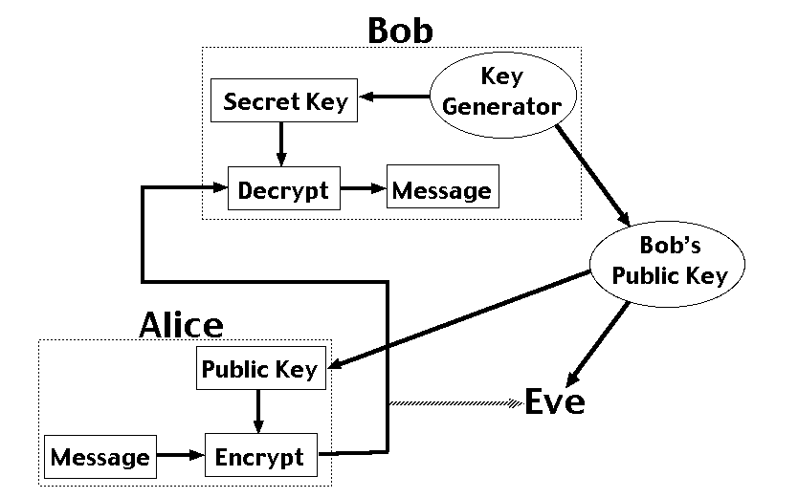
Number Theory:
Public Key Encryption
RSA – Public Key Cryptosystem (why RSA?)
Uses modular arithmetic and large primes → Its security comes from the computational difficulty
of factoring large numbers.
Notes:
Public key encryption is different, because it splits the key up into a public key for encryption and a secret key for decrpytion. It's not possible to determine the secret key from the public key. In the diagram, Bob generates a pair of keys and tells everybody (including Eve) his public key, while only he knows his secret key. Anyone can use Bob's public key to send him an encrypted message, but only Bob knows the secret key to decrypt it. This scheme allows Alice and Bob to communicate in secret without having to meet.
RSA rivest, shamir and adleman

Slide 119
Public Key Cryptography
In private key cryptosystems, the same secret “key” string is used to both encode and decode messages.
  This raises the problem of how to securely communicate the key strings.
In public key cryptosystems, instead there are two complementary keys.
  One key decrypts the messages that the other one encrypts.
This means that one key (the public key) can be made public, while the other (the private key) can be kept secret from everyone.
  Messages to the owner can be encrypted by anyone using the public key, but can only be decrypted by the owner using the private key.
    Like having a private lock-box with a slot for messages.
  Or, the owner can encrypt a message with the private key, and then anyone can decrypt it, and know that only the owner could have encrypted it.
    This is the basis of digital signature systems.
The most famous public-key cryptosystem is RSA.
  It is based entirely on number theory and uses all the number theory we have
  seen so far.

Slide 120
Rivest-Shamir-Adleman (RSA)
The private key consists of:
  A pair p, q of large random prime numbers, and
  d, an inverse of e modulo (p−1)(q−1), but not e itself.
The public key consists of:
  The product n = pq (but not p and q), and
  An exponent e that is relatively prime to (p−1)(q−1).
To encrypt a message encoded as an integer M < n:
  Compute C = Me mod n. (using exponentiation mod n)
To decrypt the encoded message C,
  Compute M = C^{d} mod n. (again, using exponentiation mod n)

Slide 121
RSA Approach
Encode:
C = Me (mod n)
M is the plaintext; C is ciphertext
n = pq with p and q large primes (e.g. 200 digits long!)
e is relative prime to (p-1)(q-1)
Decode:
C^{d} = M (mod pq)
d is inverse of e modulo (p-1)(q-1)
The process of encrypting and decrypting a message
correctly results in the original message (and it’s fast!)

Slide 122
RSA Approach
Encode:
C = Me (mod n)
M is the plaintext; C is ciphertext
n = pq with p and q large primes (e.g. 200 digits long!)
e is relative prime to (p-1)(q-1)
Ex: Encode “STOP” using RSA, with p=43;q=59 therefore n=43×59=2537, e =13;
(note that gcd(e,(p-1),(q-1)) = gcd(13,42×58)=1)
S → 18 P →19 O →14 T→15 i.e, 1819 1415, grouped into blocks of 4
1819 and 1415
Each block is encrypted using C = Me (mod n)
1819 ¹³ mod 2537 = 2081
1451 ¹³ mod 2537 = 2182
Encrypted message = 2081 2182

Slide 123
RSA Approach
Decode:
C^{d} = M (mod pq)
d is inverse of e modulo (p-1)(q-1)
d = 937 is an inverse of 13 mod (42×58=2436)
0981 ⁹³⁷ mod 2537= 0704 and 0461 ⁹³⁷ mod 2537 = 1115
So, the decoded message is 0704 1115
07 →H
04 → E
→ L
15 → P
Given the message: 0981 0461, how to decode it?

Slide 124
Why RSA Works
Theorem (Correctness of RSA): (Me)^{d} ≡ M (mod n).
Proof:
By the definition of d, we know that de ≡ 1 [mod (p−1)(q−1)].
  Thus by the definition of modular congruence,
  ∃k: de = 1 + k(p−1)(q−1).
  So, the result of decryption is
  C^{d} ≡ (Me)^{d} = Mde = M^{1+k(p−1)(q−1)} (mod n)

Slide 125
Proof cont.
  We had:
  C^{d} ≡ (Me)^{d} = Mde = M^{1+k(p−1)(q−1)} (mod n)
Assuming that M is not divisible by either p or q,
  Which is nearly always the case when p and q are very large
  Fermat’s Little Theorem tells us that
  M^{p−1}≡1 (mod p) and M^{q−1}≡1 (mod q)
Thus, we have that the following two congruences hold:
  First: C^{d} ≡ M · (M^{p−1})^{k(q−1)} ≡ M·1^{k(q−1)} ≡ M (mod p)
  Second: C^{d} ≡ M·(M^{q−1})^{k(p−1)} ≡ M·1^{k(p−1)} ≡ M (mod q)
  Hmm. System of modular equations…

Slide 126
Proof cont.
  We had:
  C^{d} ≡ (Me)^{d} = Mde = M^{1+k(p−1)(q−1)} (mod n)
Assuming that M is not divisible by either p or q,
  Which is nearly always the case when p and q are very large
  Fermat’s Little Theorem tells us that
  M^{p−1}≡1 (mod p) and M^{q−1}≡1 (mod q)
Thus, we have that the following two congruences hold:
  First: C^{d} ≡ M · (M^{p−1})^{k(q−1)} ≡ M·1^{k(q−1)} ≡ M (mod p)
  Second: C^{d} ≡ M·(M^{q−1})^{k(p−1)} ≡ M·1^{k(p−1)} ≡ M (mod q)
  Hmm. System of modular equations…

Slide 127
Proof cont.
Thus, we have that the following two congruences hold:
  First: C^{d} ≡ M · (M^{p−1})^{k(q−1)} ≡ M·1^{k(q−1)} ≡ M (mod p)
  Second: C^{d} ≡ M·(M^{q−1})^{k(p−1)} ≡ M·1^{k(p−1)} ≡ M (mod q)
  Hmm. System of modular equations…
And since gcd(p,q) = 1, we can use the Chinese Remainder Theorem
to show that therefore C^{d} ≡ M (mod pq), since
  If C^{d} ≡ M (mod pq) then ∃s: C^{d} = s p q + M,
  so C^{d} ≡ M (mod p) and also C^{d} ≡ M (mod q).
  Thus, M is a solution to these two congruences,
  so (by CRT) it’s the only solution.
  QED

